Slide 1
CSCI-6660 ARTIFICIAL INTELLIGENCE Project BREAST CANCER PREDICTION
By
Shyam sunder Reddy Beeram
Priyanka Nandigam
Sridevi Jaidi

Slide 2
Abstract
Breast cancer is one of the main causes of cancer death worldwide. Computer-aided diagnosis systems showed the potential for improving diagnostic accuracy. But early
detection and prevention can significantly reduce the chances of death. It is important to detect breast cancer as early as possible.
The goal is to classify images into two classifications of malignant and benign. As early diagnostics significantly increases the chances of correct treatment and
survival. In this application, we are helping the doctors and patients to classify the Type of Tumour for the specific image given with the help of Neural Networks.

Slide 3
Acknowledgement
While developing this project, I have learned a lot of new emerging technology in AI which helped me in gaining practical knowledge with the conceptual understanding and helped me to build confidence which may help in developing various projects. I am very thankful to professor for giving such a great opportunity to explore my ideas in the stream.
I heartily thank our prof. SHIVANJALI K, for her guidance and suggestions during this project development.

Slide 4
Introduction
Every project/invention/discovery begins with an idea. Here my idea is how to use Image recognition technology in making a real world application, resulted in developing this project.
we are helping the doctors and patients to classify the Type of Tumour for the specific image given with the help of Neural Networks.

Slide 6
Features
Ability to upload an image
Recognizing the uploaded image
Displaying the details of the image uploaded
Storing the data to the database (There is a separate folder named uploads in the database)
Classifying the data uploaded according to their species

Slide 7
Key Terms
CNN: Convolutional Neural Network is an algorithm specially designed for working with Images and videos. It takes images as inputs, extracts and learns the features of the image, and classifies them based on the learned features
Dense Layer:Dense is the only actual network layer in that model. A Dense layer feeds all outputs from the previous layer to all its neurons, each neuron providing one output to the next layer. It's the most basic layer in neural networks.

Slide 8
Core of project
The technology/concept behind the project is CNN.
We use python and its libraries to load explore and analyze the data.
Then we preprocess the data.
Pre-process[resize, rescale, converting labels]
In our preprocessing module it consists of loading dataset, initializing dataset,
Building CNN layers, training and saving the model.
We saved the model in H5 format
Then we optimize the code and load the saved model and test the results.
Then we build an application (App built in a way that usage is friendly)
Server scripting code (flask concept).
Integrating the app code with our saved model and HTML file
Then test the Results

Slide 9
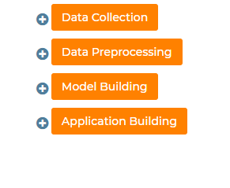
Method
Lets look the flow of project.

Slide 10
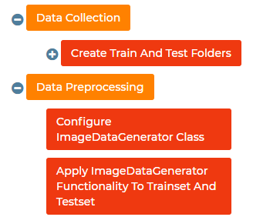
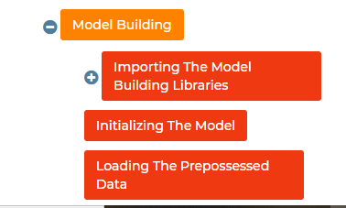

Slide 11
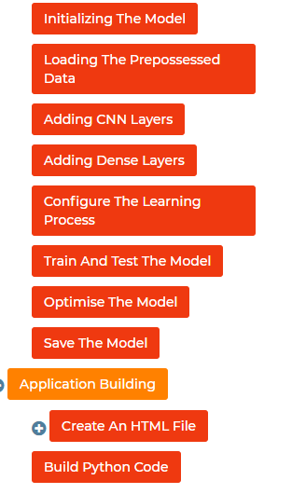

Slide 12
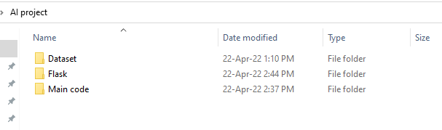
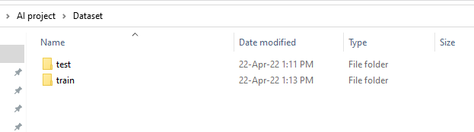
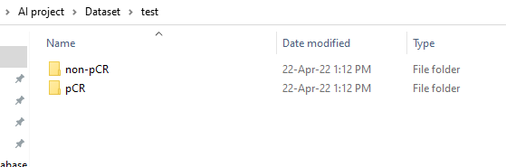
Project Structure

Slide 13
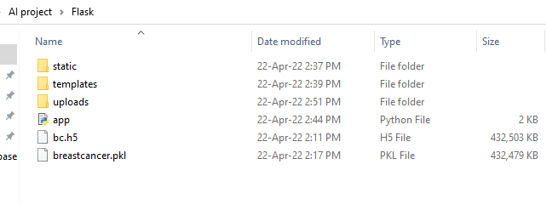
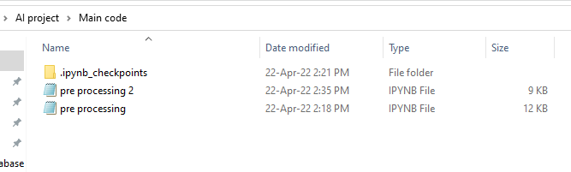

Slide 14
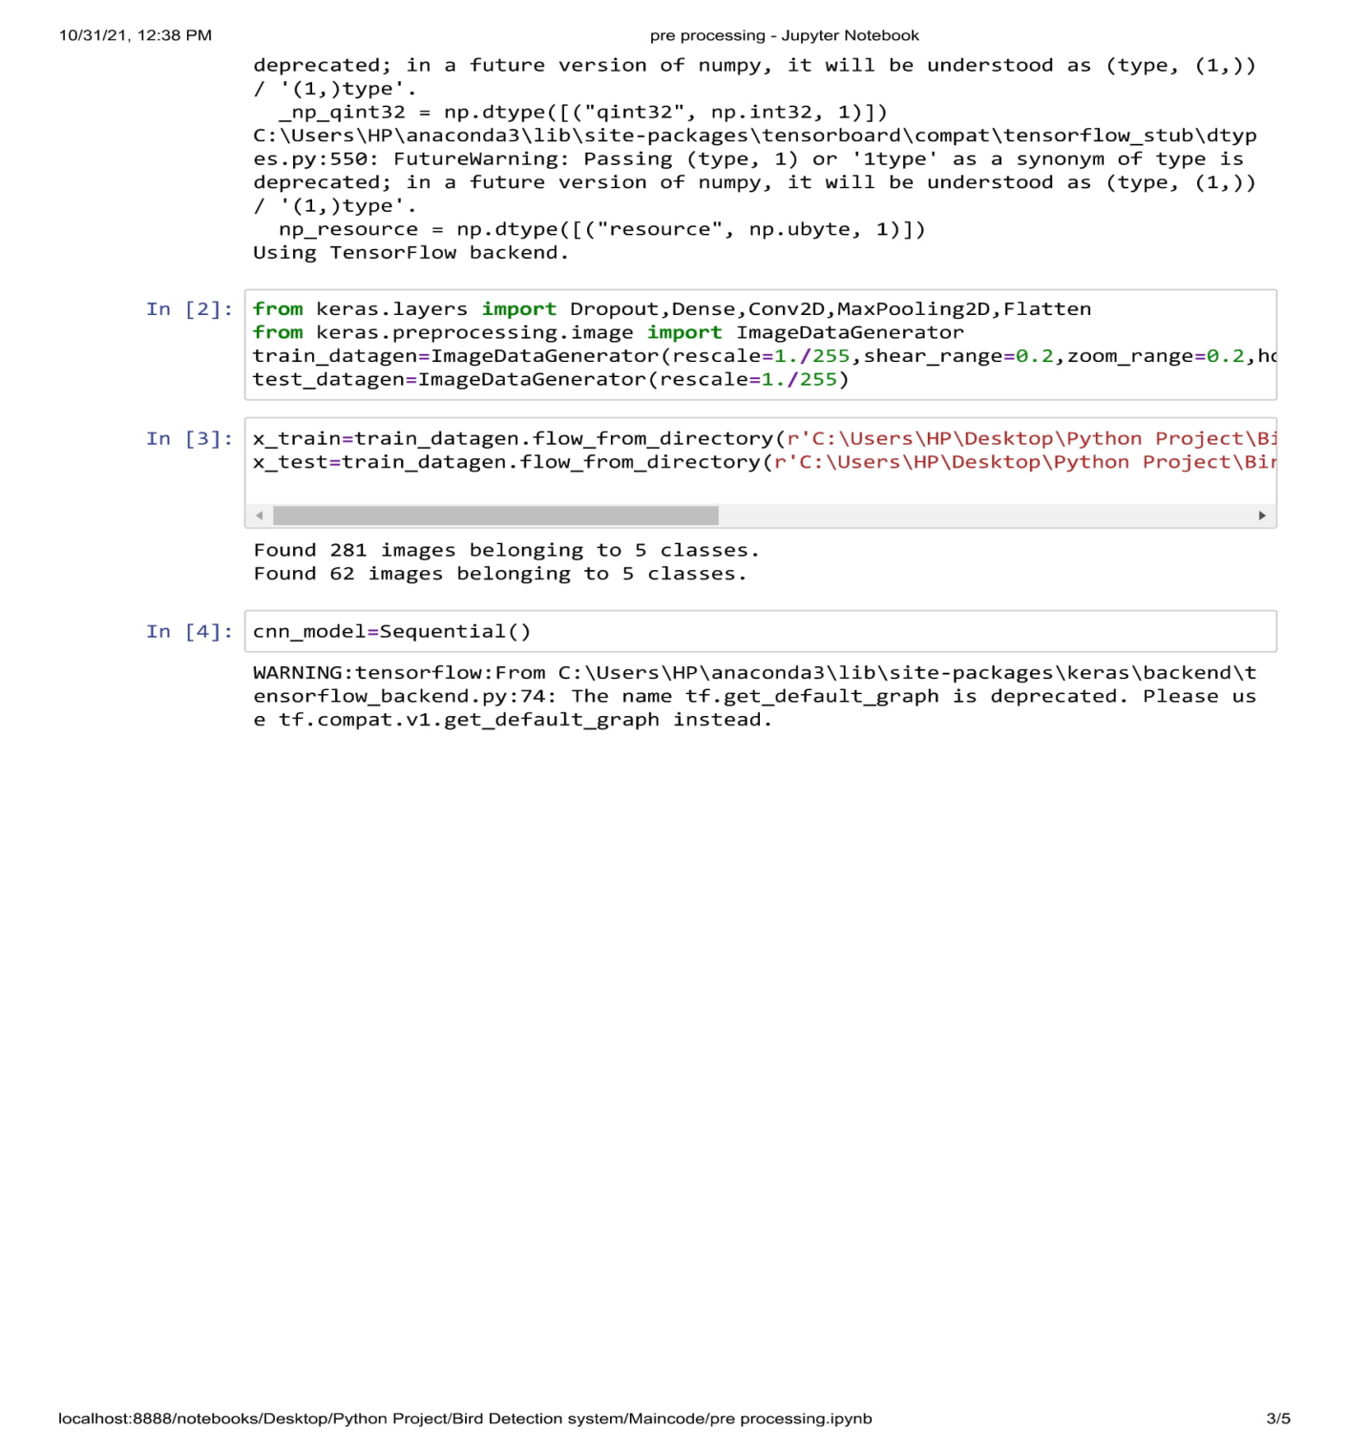

Slide 15
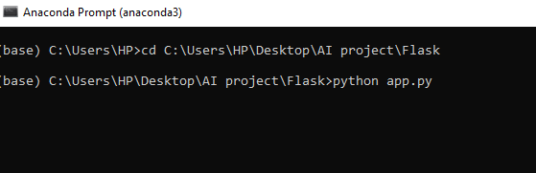
Execution
Executing in command prompt

Slide 16
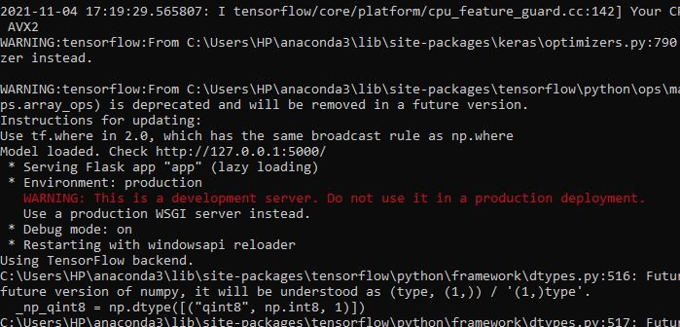

Slide 17
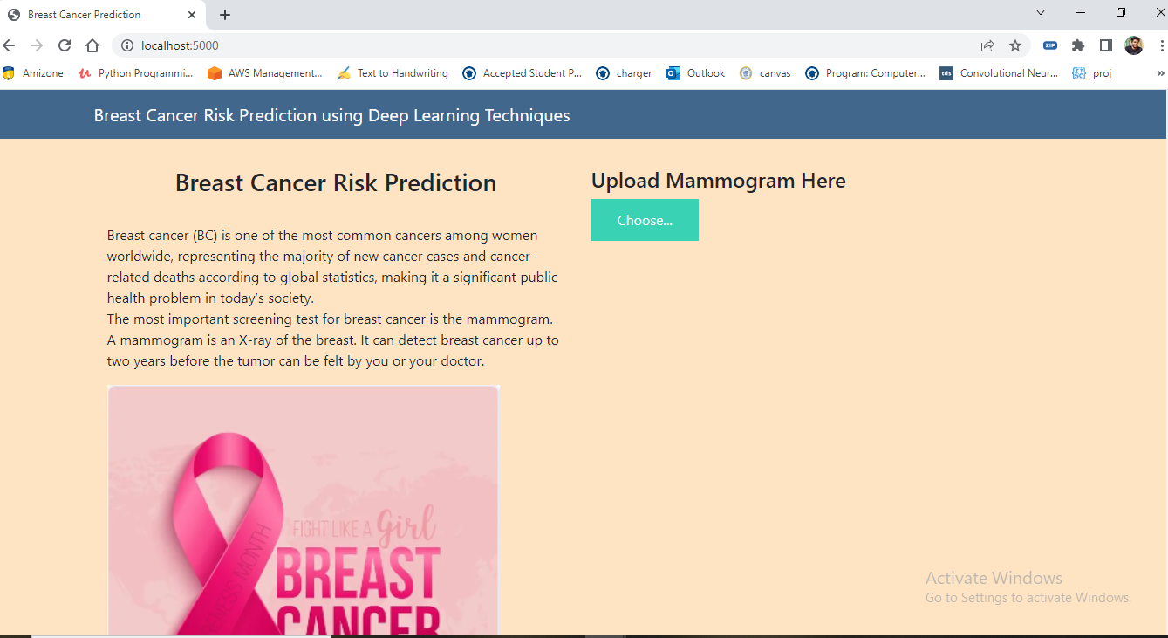
Result

Slide 18
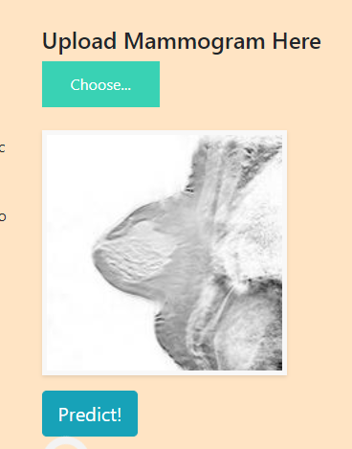

Slide 19
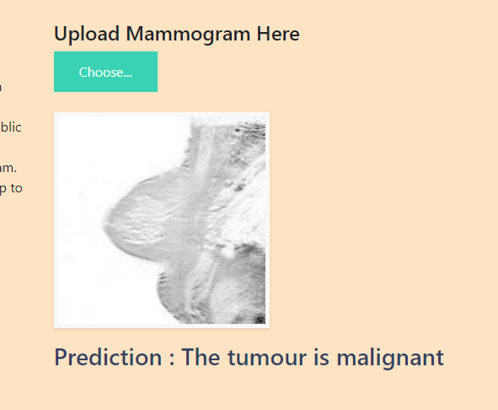

Slide 20
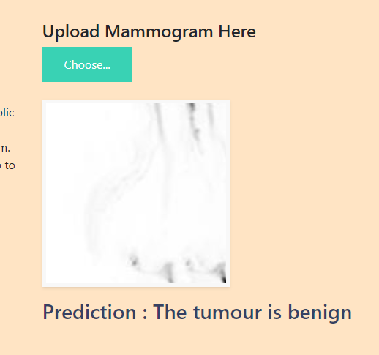

Slide 21
LIVE-DEMO
This will be by the possibility

Slide 22
Conclusion
The main objective is to classify images into two classifications of malignant and benign. As early diagnostics significantly increases the chances of correct treatment and survival, and we achieved that.

Slide 23
Accomplishments
By the end of this project we are
Able to work with python
Able to Work with Http Requests
Able to work with Flask integration
confidence that may help in developing future projects
Punctuality & Procedure

Slide 24
Thank you !

